Slide 1
BC2406 Presentation
Group 6 Members
CHUA WEI JIAN (U1810087C)
NG YAN MING (U1910470H)
TEY CHIN YI (U1920368L)
TING NAI XIANG, MATTHEW (U1922331J)

Slide 2
AGENDA
01
02
03
04
05
06
OVERVIEW
DATA
TEXT MINING
LINEAR REGRESSION
CART
CONCLUSION

Slide 3
01
OVERVIEW

Slide 4
PROBLEM
IMPERFECT KNOWLEDGE
BEHAVIORAL BIAS
Stability Bias
Lack of time

Slide 5
02
DATA

Slide 6

DATASET
Publicly Available Data of US Mutual Funds from Yahoo! Finance
(Yahoo!, 2020)
Notes:
Yahoo!. (2020). Yahoo! Logo [Image]. Retrieved from https://sg.finance.yahoo.com/

Slide 7
DATA CLEANING (EXPLORATION)
REMOVE NON-LARGE GROWTH
FIND NUMBER AND HEIOF SECTORS AND HIGH
STANDARDIZE THE WEIGHTAGE
PHASE 4

Slide 8
DATA CLEANING
1. REMOVE NON-LARGE GROWTH CATEGORIES
3. FIND NUMBER OF SECTORS INVESTED
5. REMOVE NA VALUES FOR RATE OF RETURNS
4. FIND HIGHEST WEIGHTAGE OF EACH FUND
6. REMOVING UNNECESSARY COLUMNS
2. STANDARDIZE THE WEIGHTAGE

Slide 9
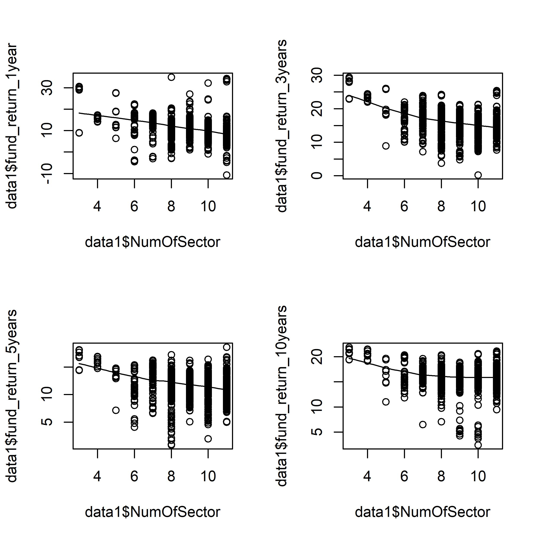
DATA EXPLORATION

Slide 10
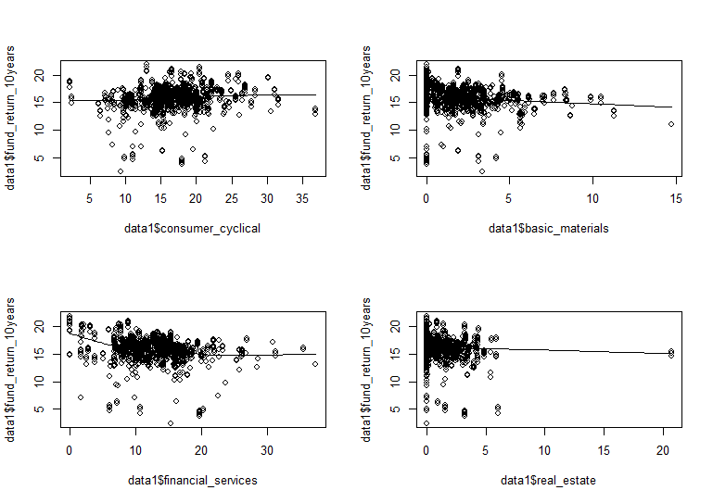
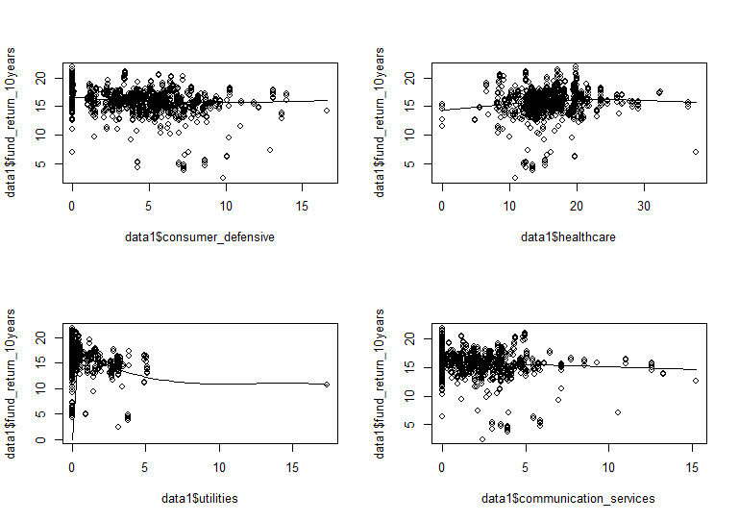
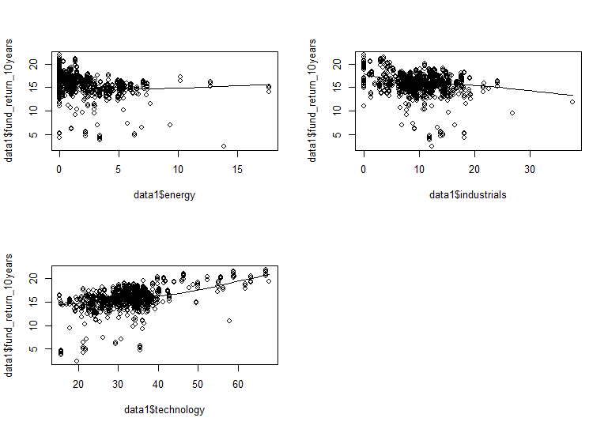
DATA EXPLORATION

Slide 11
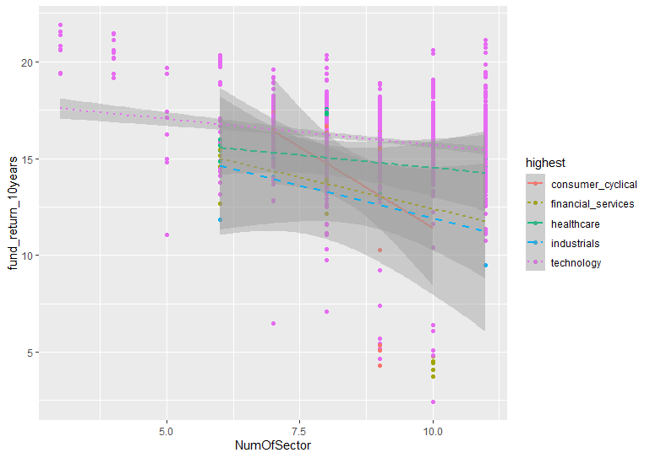
DATA EXPLORATION

Slide 12
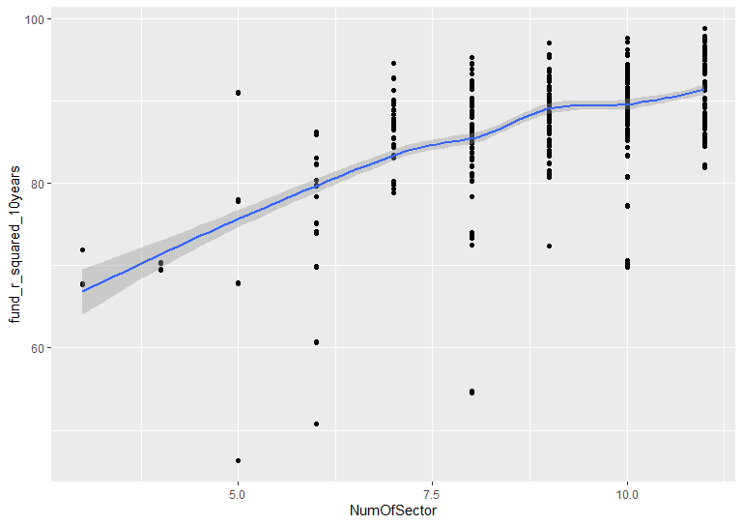
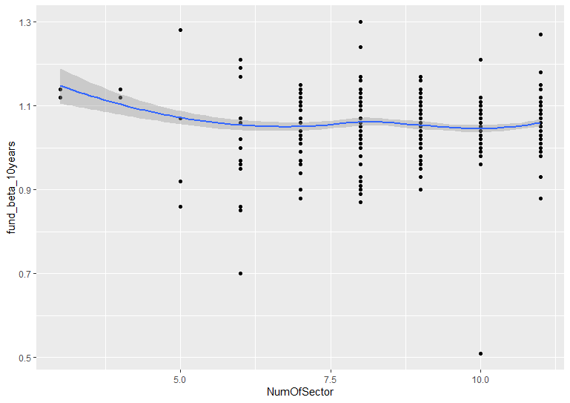
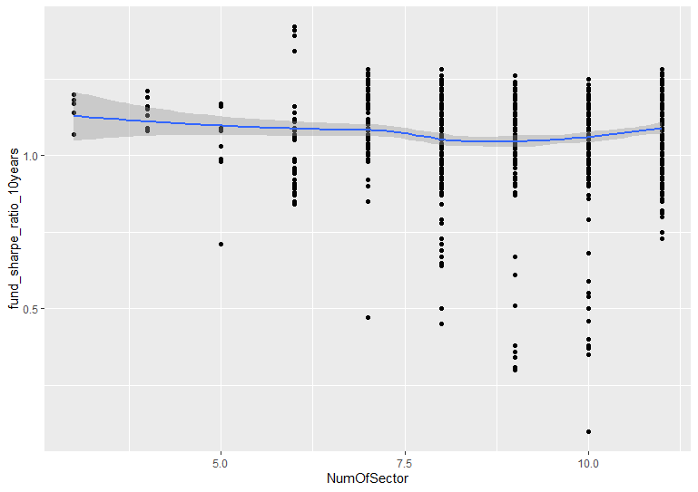
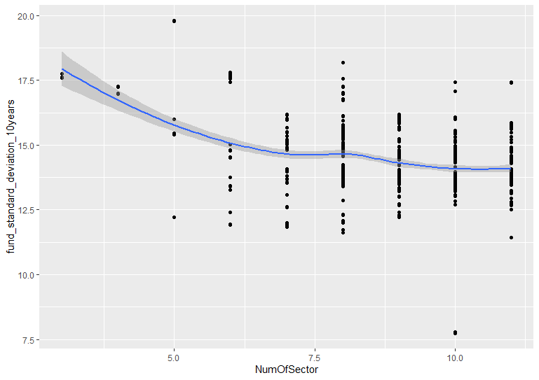
DATA EXPLORATION

Slide 13
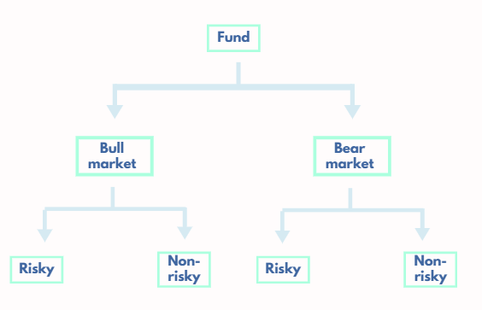
OVERALL SOLUTION

Slide 14
03
TEXT MINING

Slide 15
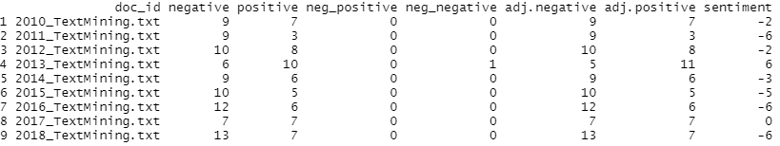
SENTIMENTS

Slide 16
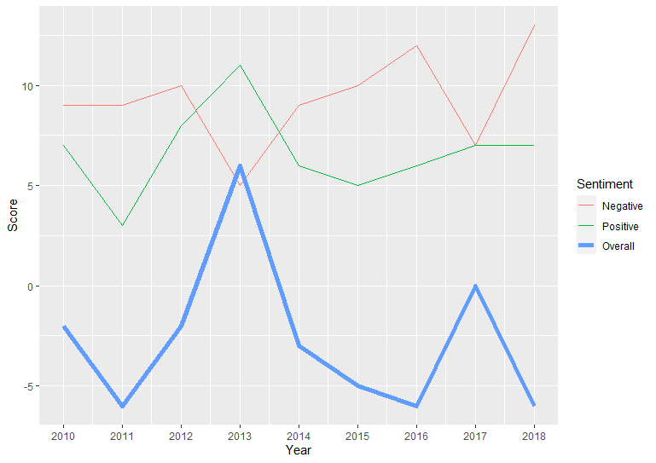
SENTIMENTS TRENDS

Slide 17
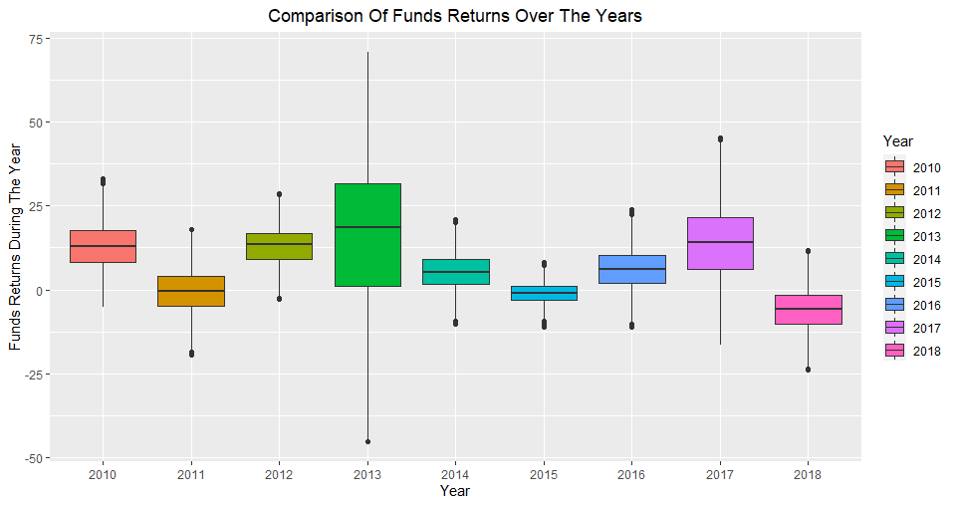
RELATION TO RETURNS

Slide 18
04
LINEAR REGRESSION

Slide 19
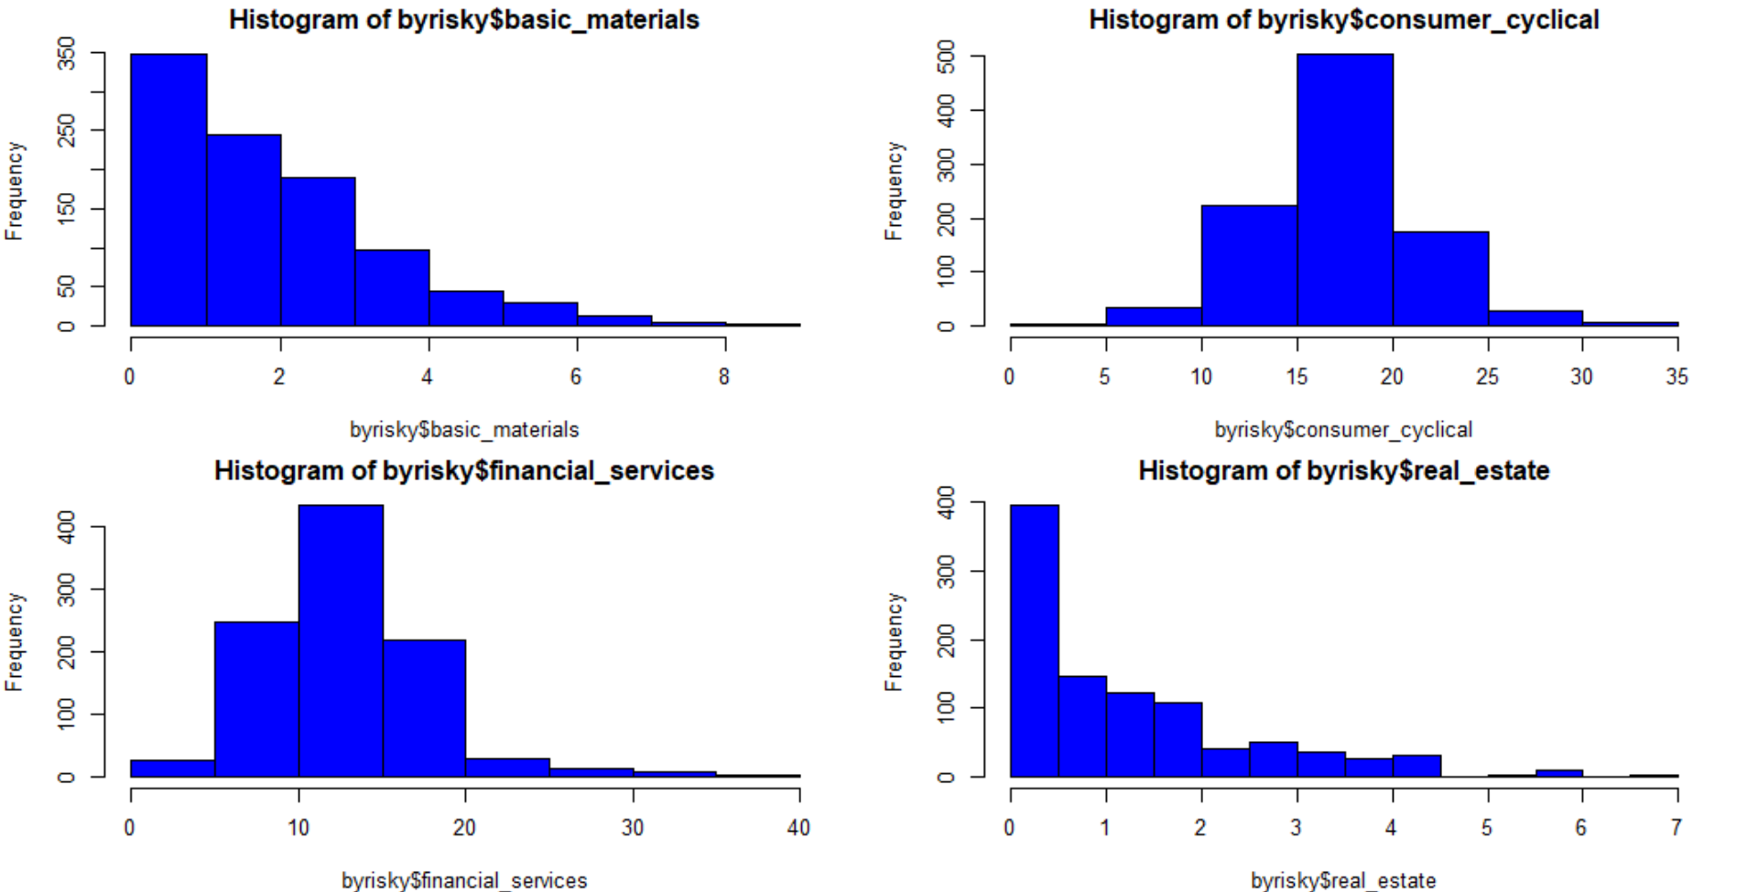
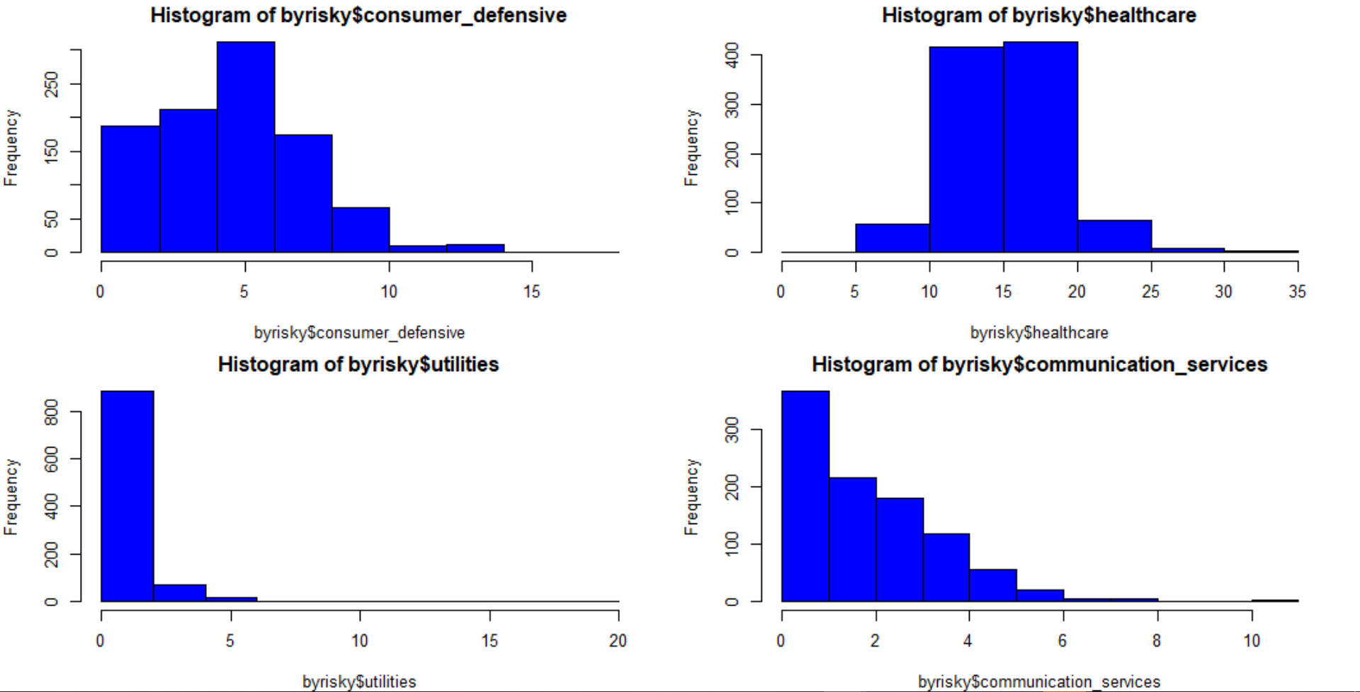
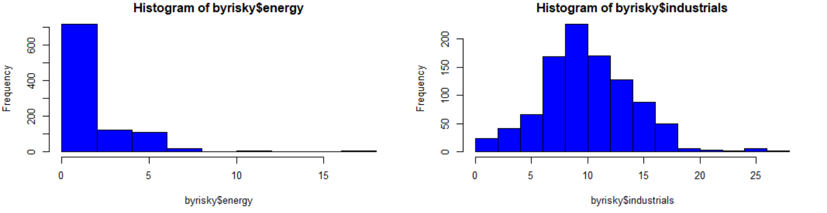
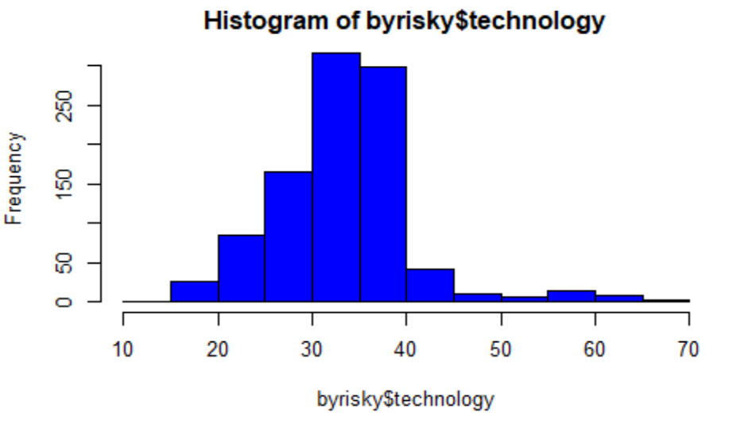
RANGE OF SECTOR

Slide 20
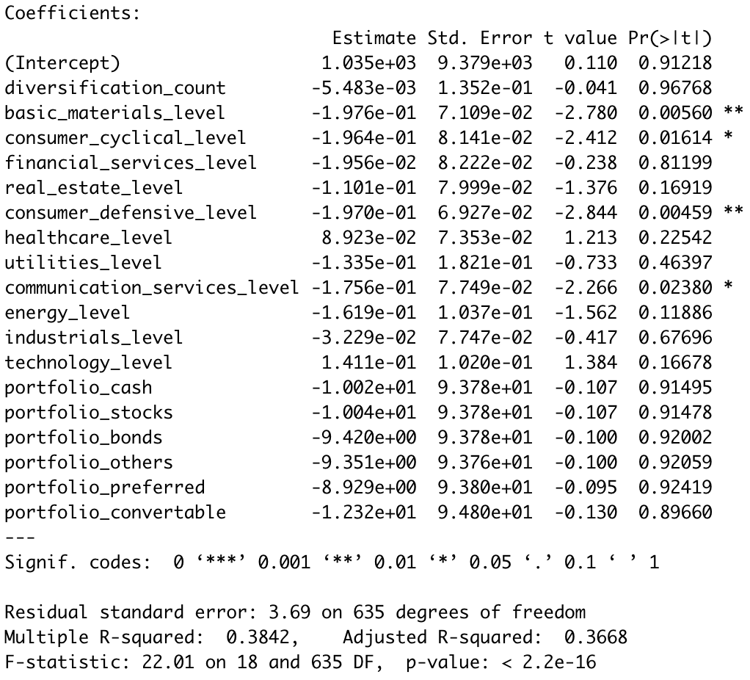
MODEL CHOSEN

Slide 21

RSME

Slide 22
05
CART

Slide 23
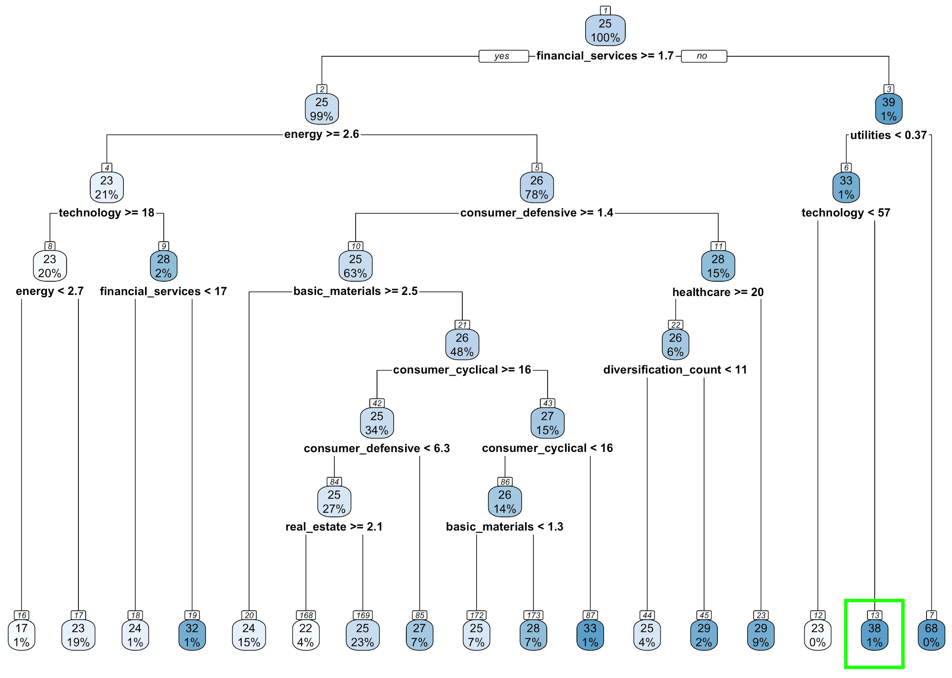
CART MODEL

Slide 24
VARIABLE IMPORTANCE

Slide 25
06
CONCLUSION

Slide 26
LIMITATIONS
Rapid Changing Market
Focus only on US Mutual Funds
Risk appetite limited to 2 categories

Slide 27
MOBILE
APPLICATION
INPUT
OUTPUT
Risk Level
Recommended Composition

Slide 28
THANK YOU

